Slide 1
Predictive Analytics with Spark in Azure HDInsight
Ingyu Lee
Troy University

Slide 2
Content
HDInsight – What is it?
What is Spark?
What is RDD?
What is DataFrames?
What is Spark SQL?
Whati is MLLib?
References
Microsoft DAT202.3x: Spark in Azure HDInsight
Microsoft DAT202.2x: Hadoop in Azure HDInsight
Microsoft DAT202.1x: Big Data with Hadoop in Azure HDInsight
Microsoft Virtual Academy: Spark on HDInsight
UCB Sparks: CS105, CS110, CS120
UCSD Big Data Series (Coursera)
Yandex: Big Data Series (Coursera)

Slide 3
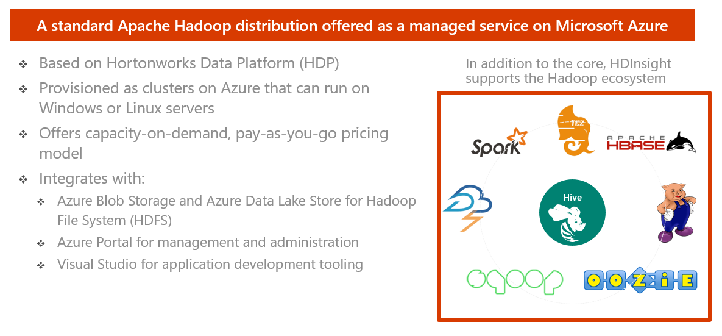
HDInsight – What is it?

Slide 4
HDInsight and Hadoop ecosystem
Pipeline / workflow
(Oozie)
JavaScript
C#, F#, .NET
Graph
(Pegasus)
Stats processing
(SparkR)
Machine Learning
(Mahout)
Data Integration
(ODBC / SQOOP/ REST)
Relational
(SQL Server)
Legend
Red =
Core Hadoop
Blue = Data processing
Gray = Microsoft integration points and value adds
Orange =
Data movement
Green = Packages
Metadata
(HCatalog)
PDW Polybase
Real Time Processing (Storm)
NoSQL Database
(HBase)
Scripting
(Pig)
Query
(Hive)
Event Driven Processing
Distributed Processing
(MapReduce)
Event Pipeline
(Event Hub/ Flume)
Business Intelligence
(Excel, Power View, SSAS)
YARN
Distributed Storage (HDFS)
Monitoring & Deployment (System Center)
World's Data (Azure Data Marketplace)
Azure Storage Vault (ASV)
Active Directory (Security)

Slide 5
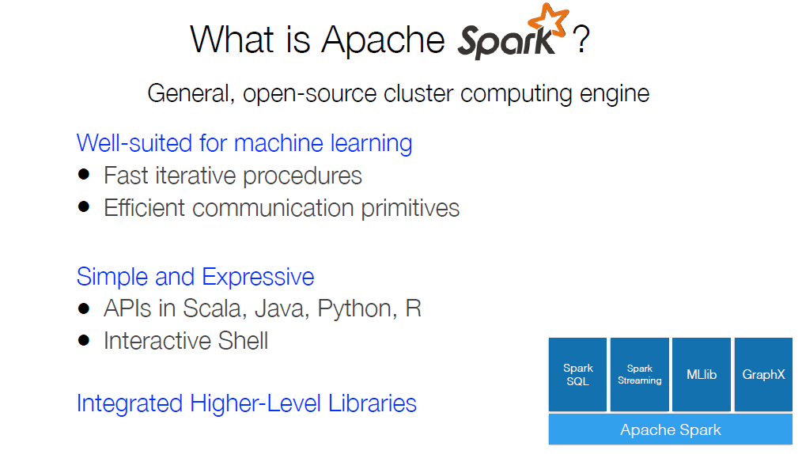
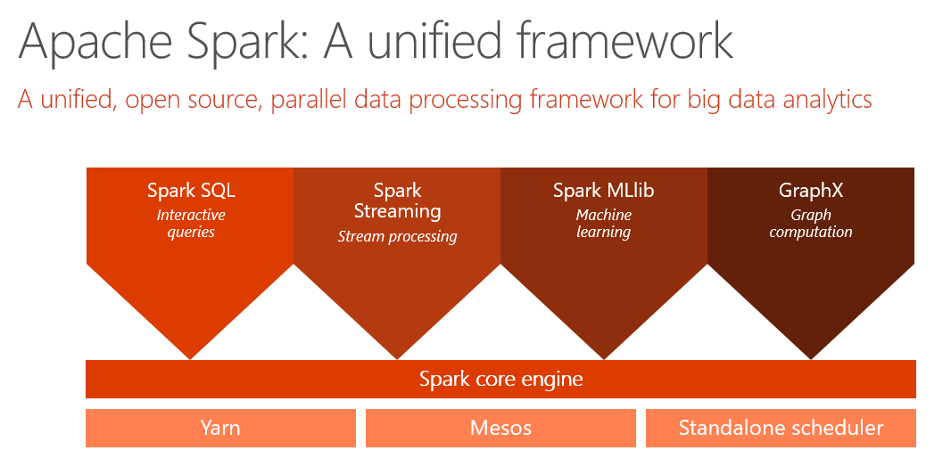

Slide 6
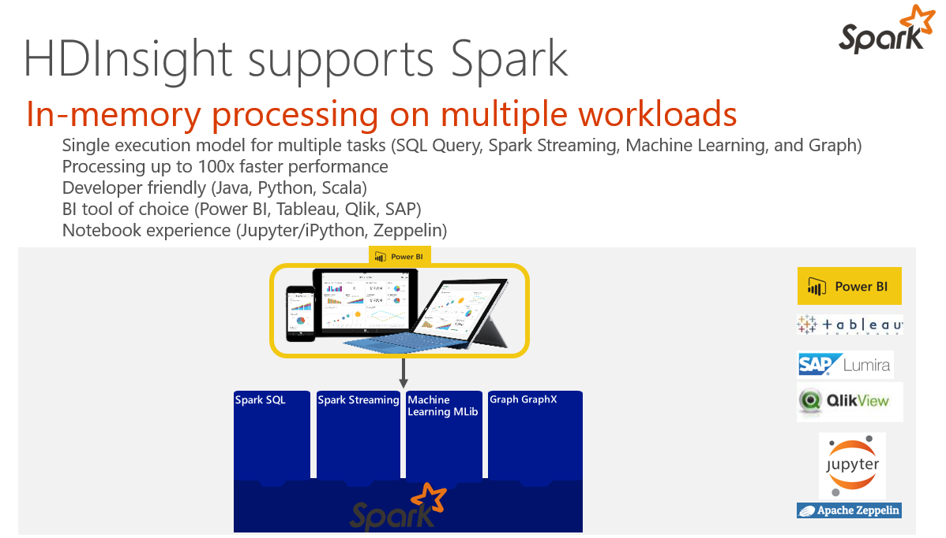

Slide 7
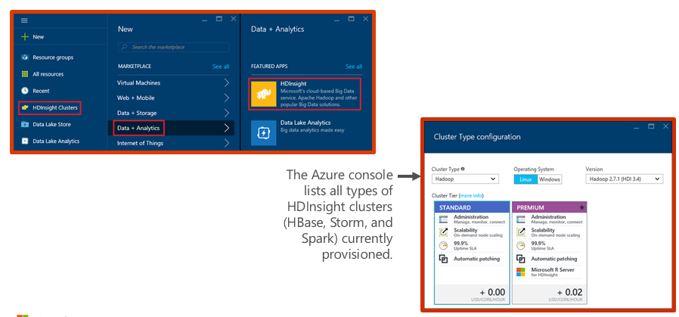
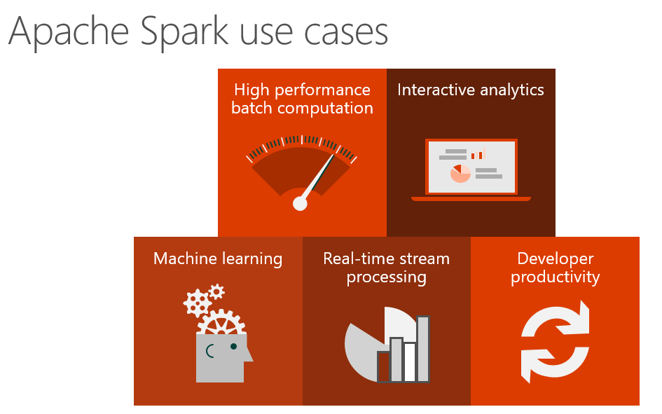
Demo: Creating an HDInsight Spark cluster

Slide 8
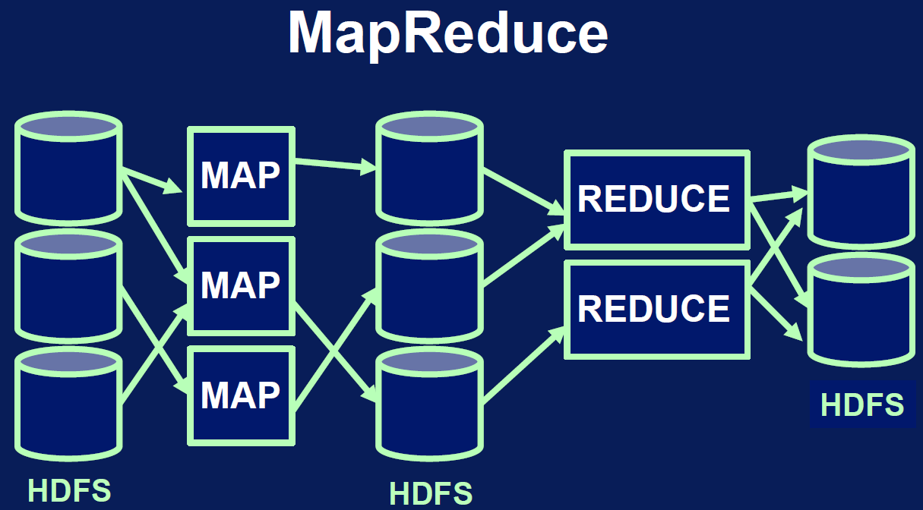
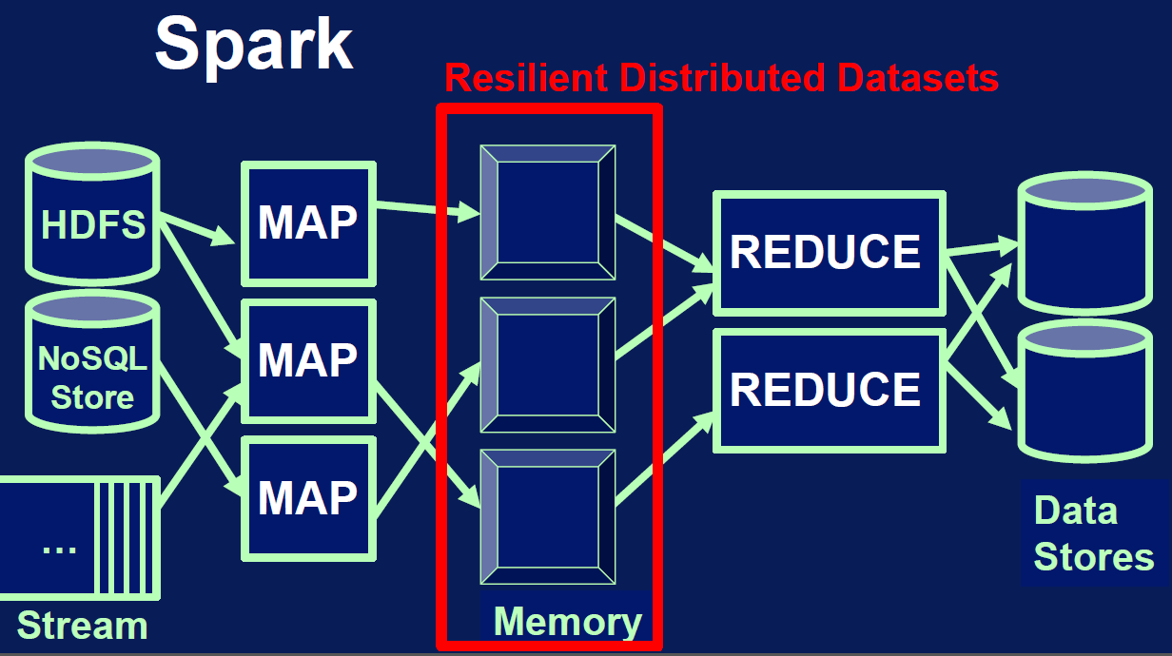
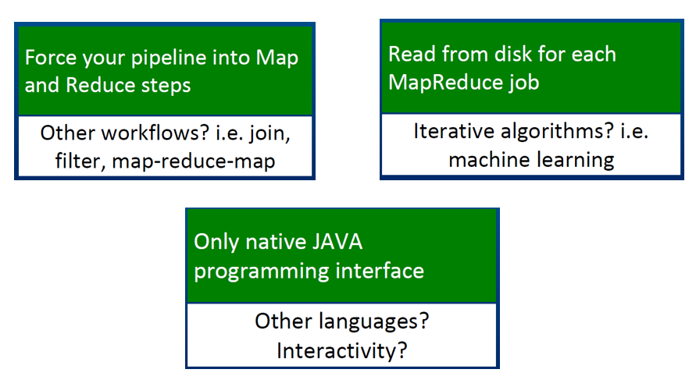
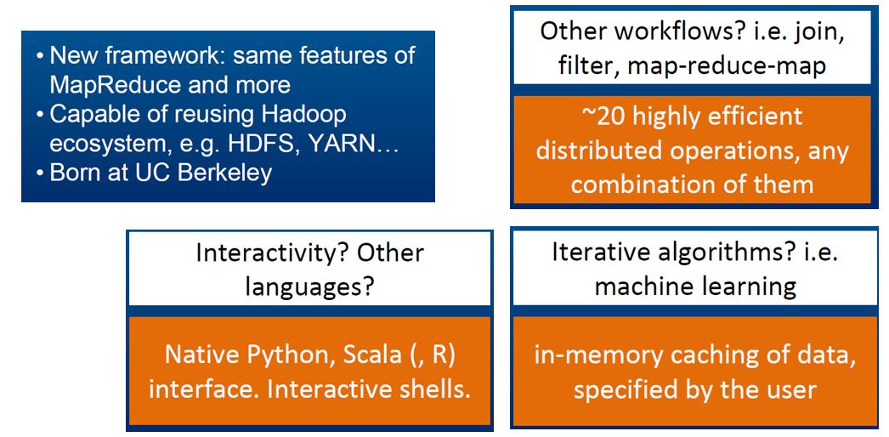
Hadoop vs. Spark

Slide 9
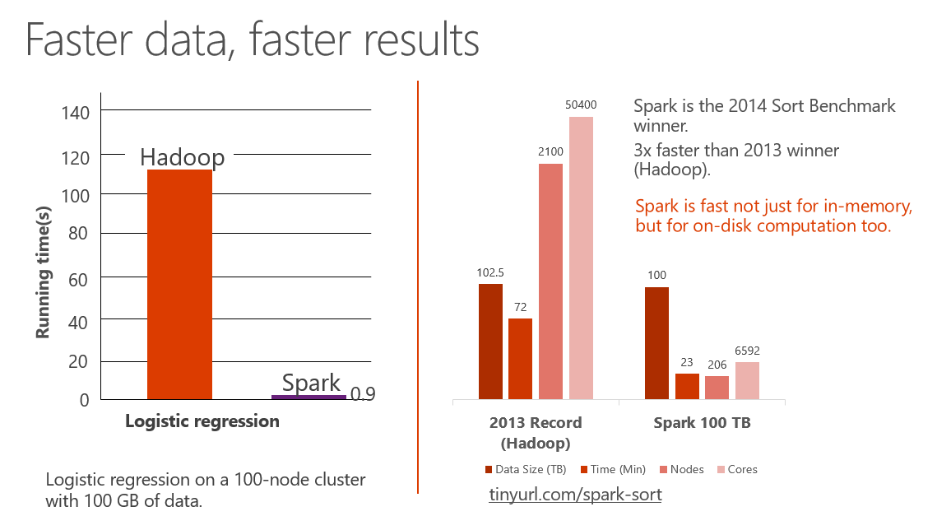
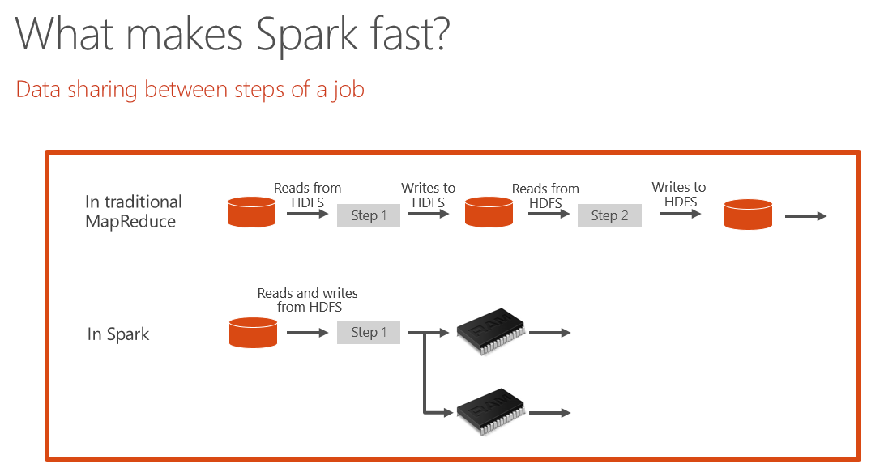
Why sparks?

Slide 10
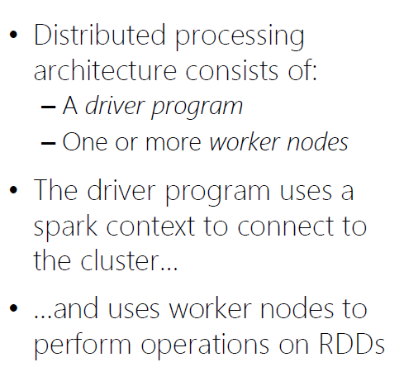
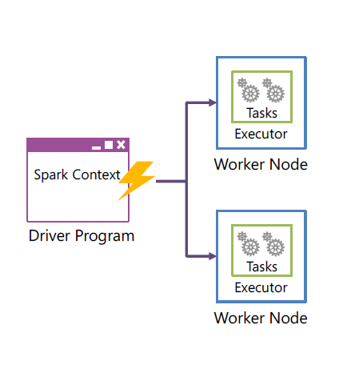
Spark cluster architecture

Slide 11
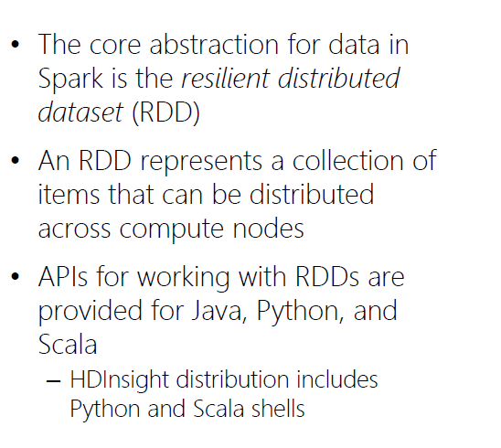
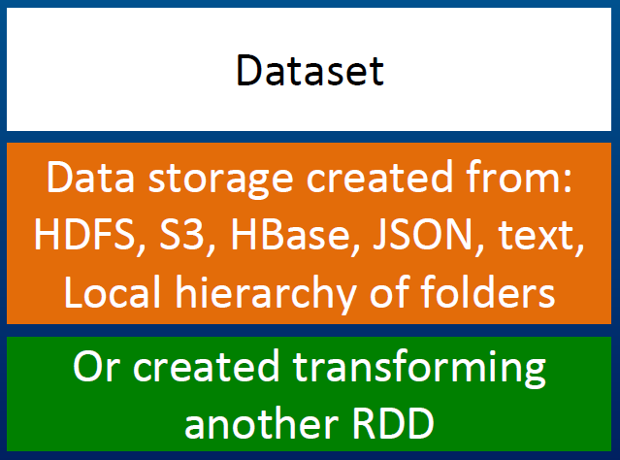
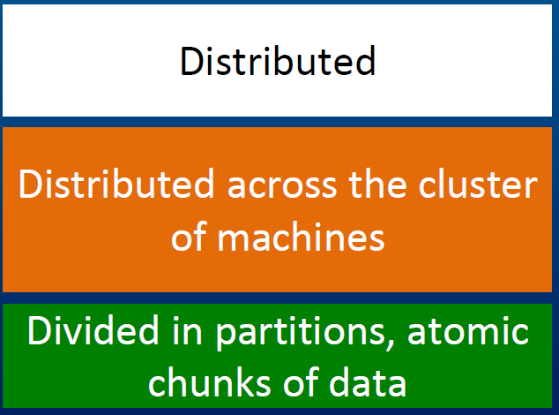
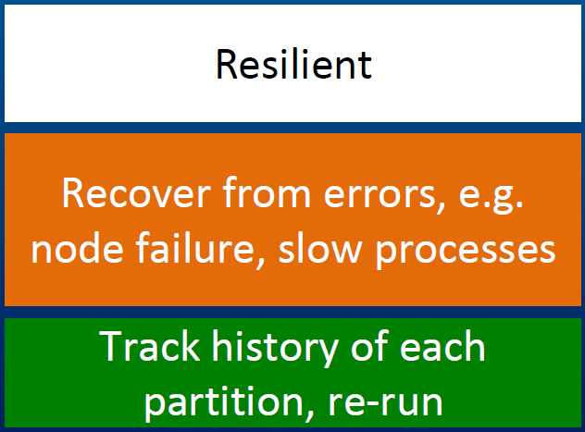
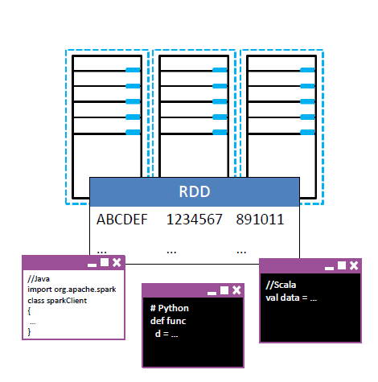
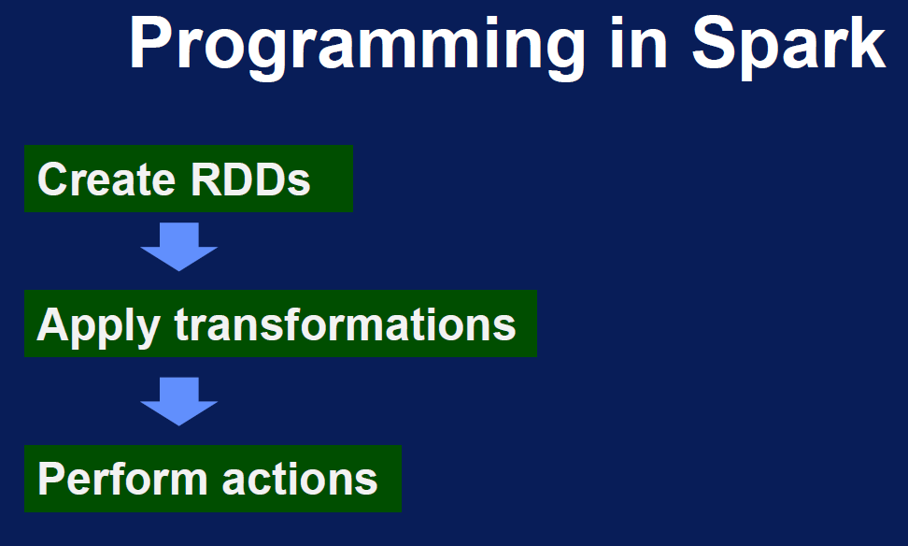
What is RDD?

Slide 12
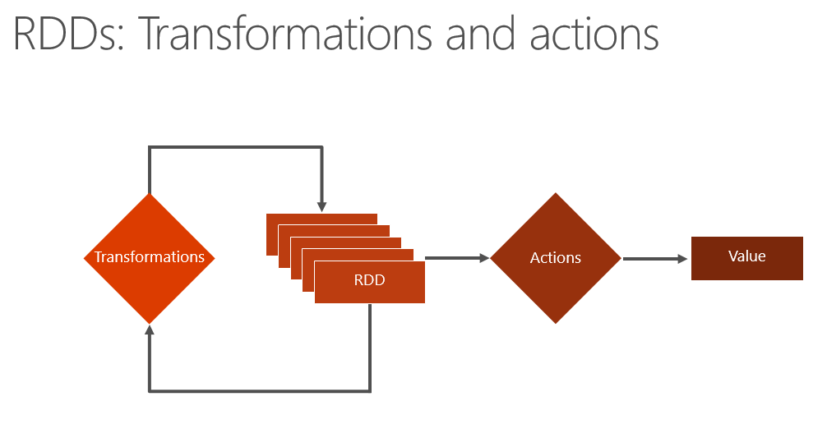
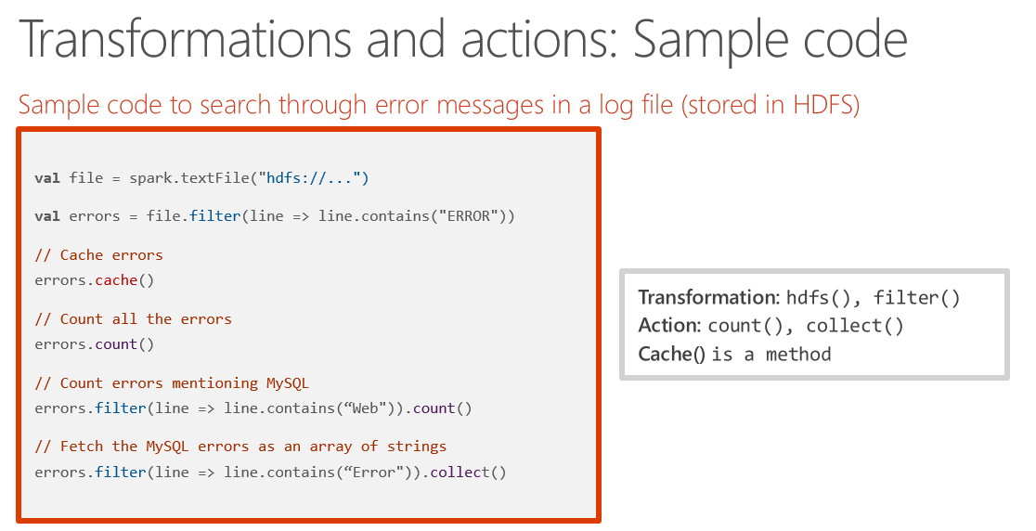
RDD Operations

Slide 13
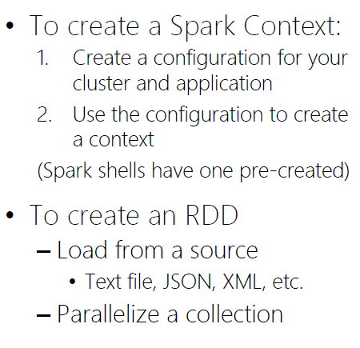
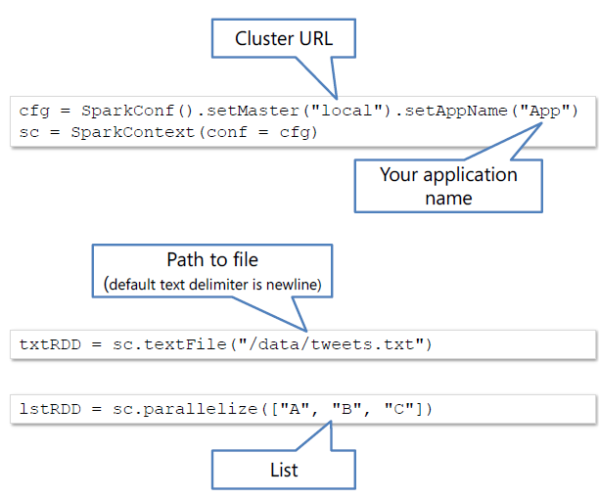
RDD Operations

Slide 14
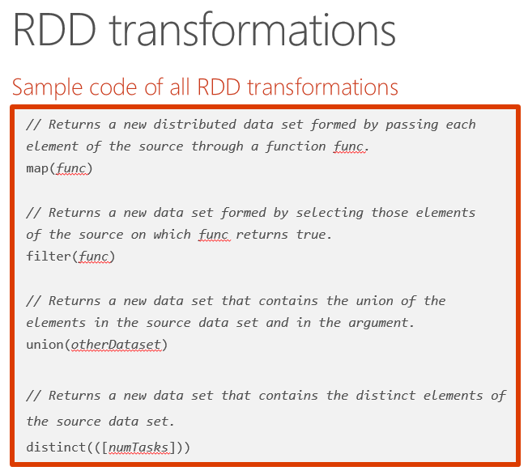
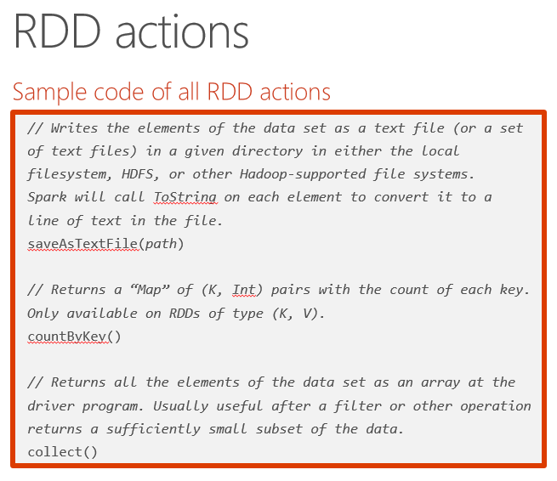
RDD Operations

Slide 15
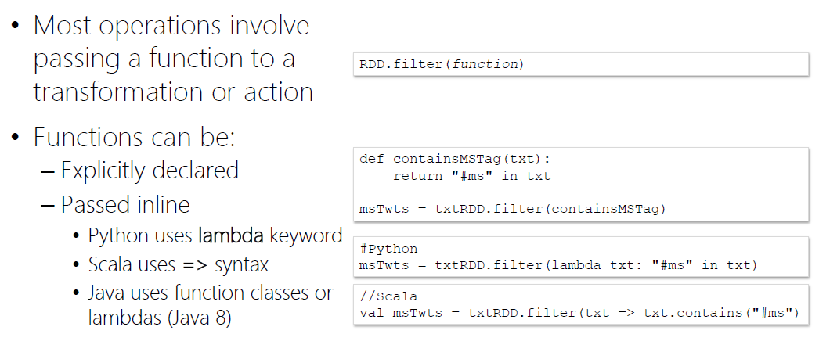
Demo: Working with RDDs in Python

Slide 16
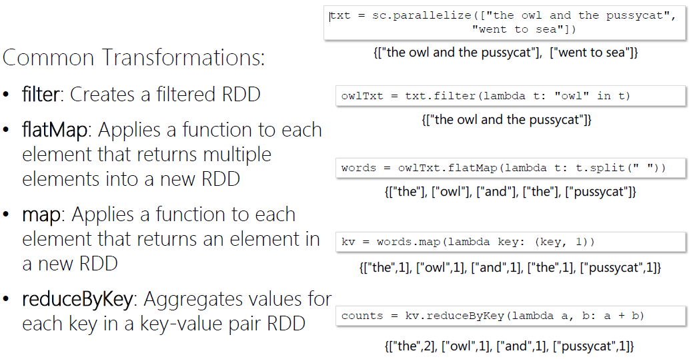
RDD Operations

Slide 17
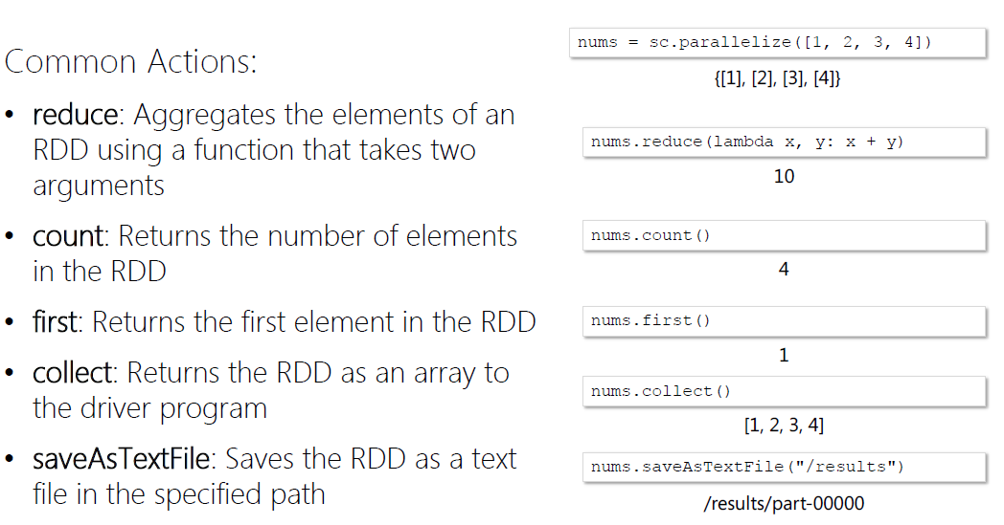
RDD Operations

Slide 18
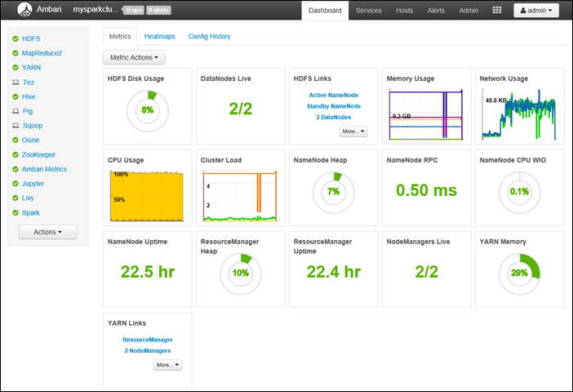
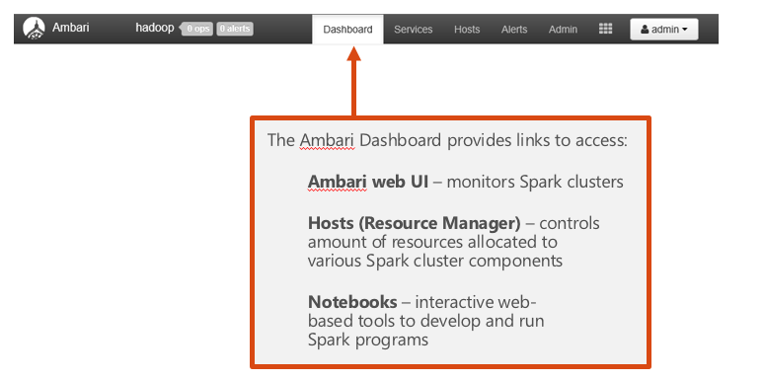
Ambari Dashboard

Slide 19
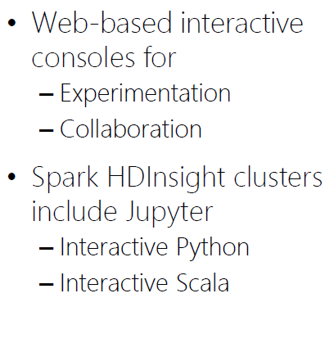
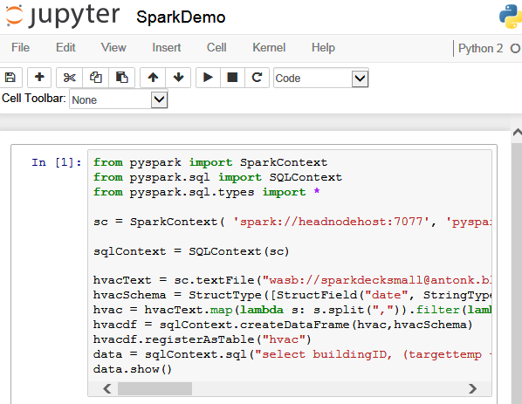
HDInsight Spark: Jupyter notebooks

Slide 20
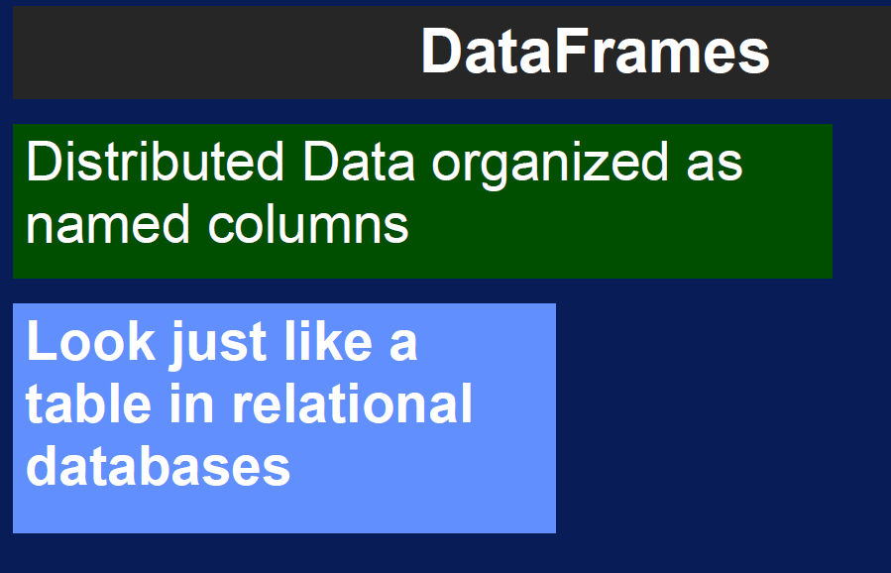
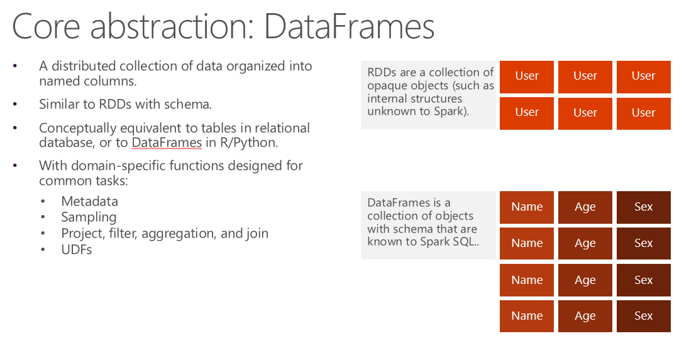
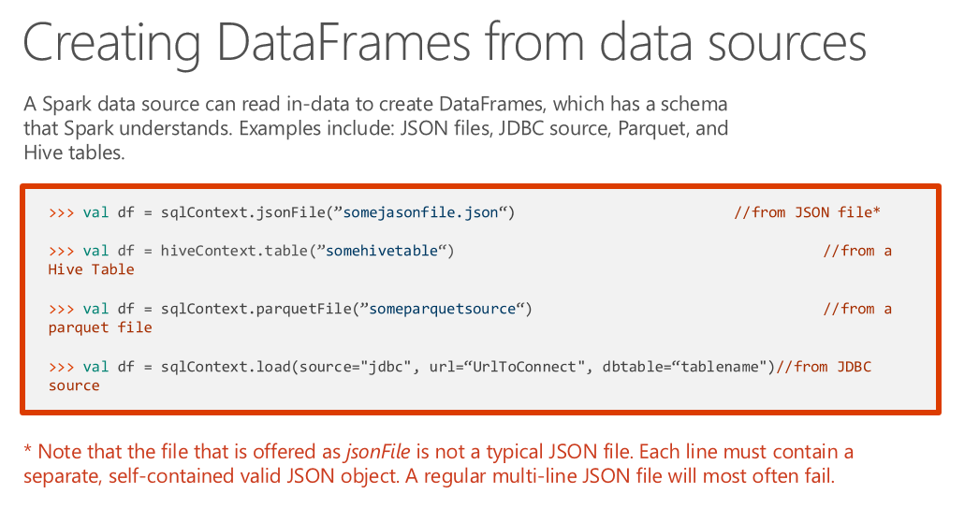
What is DataFrames?

Slide 21
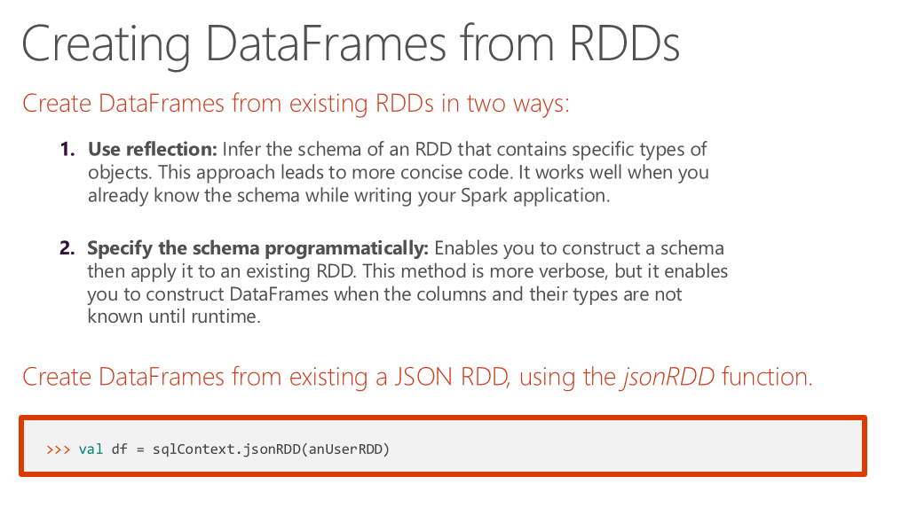
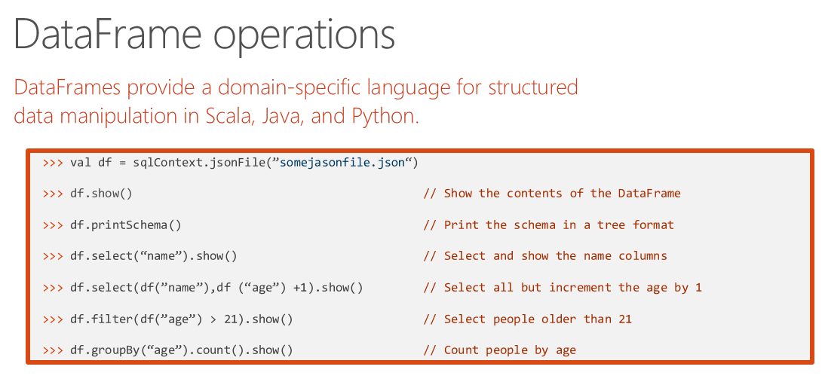
DataFrame Operations

Slide 22
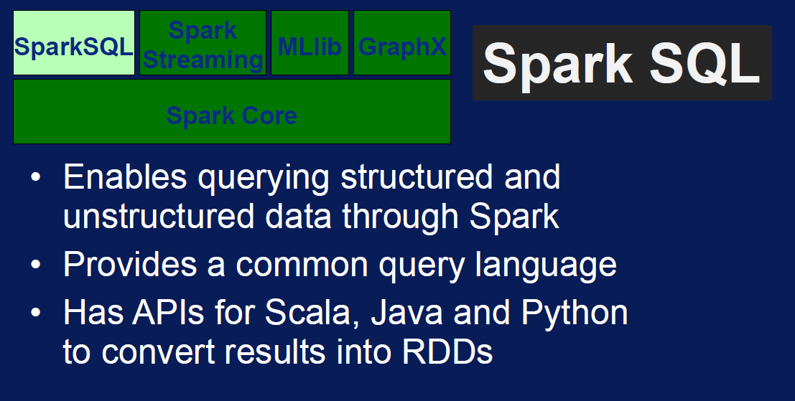
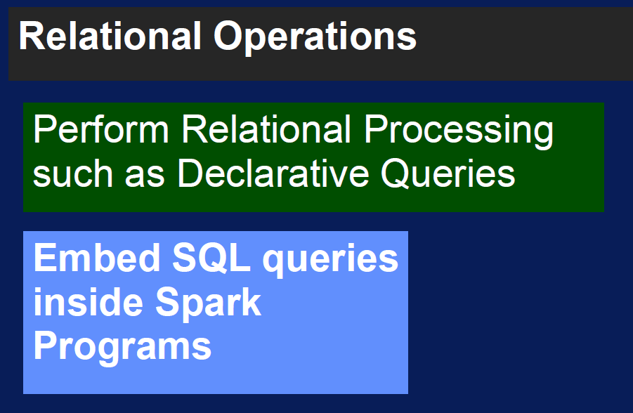
What is Spark SQL?

Slide 23
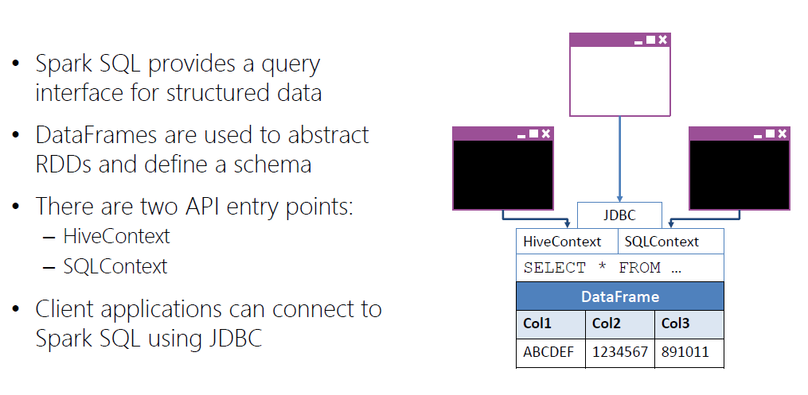
Spark SQL

Slide 24
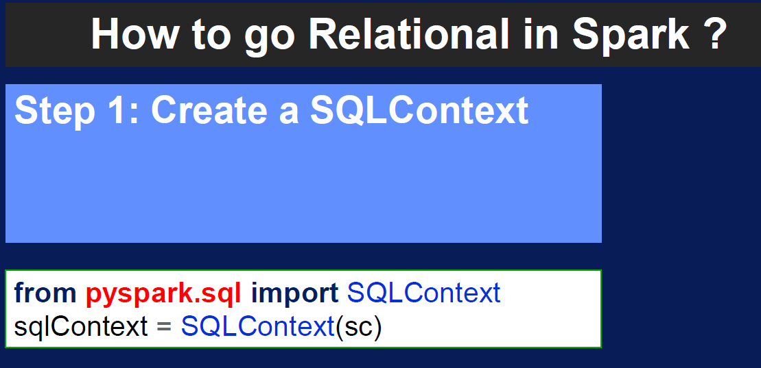
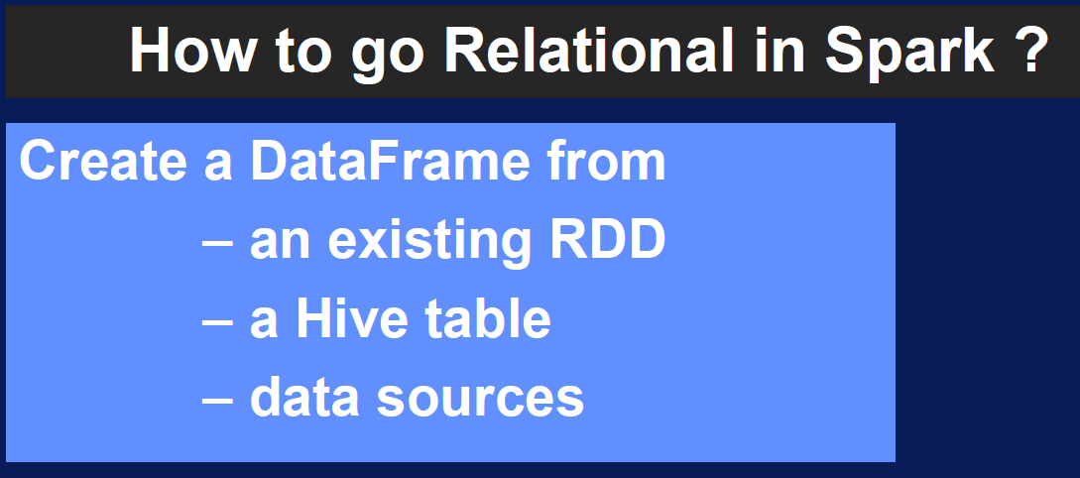
Spark SQL

Slide 25
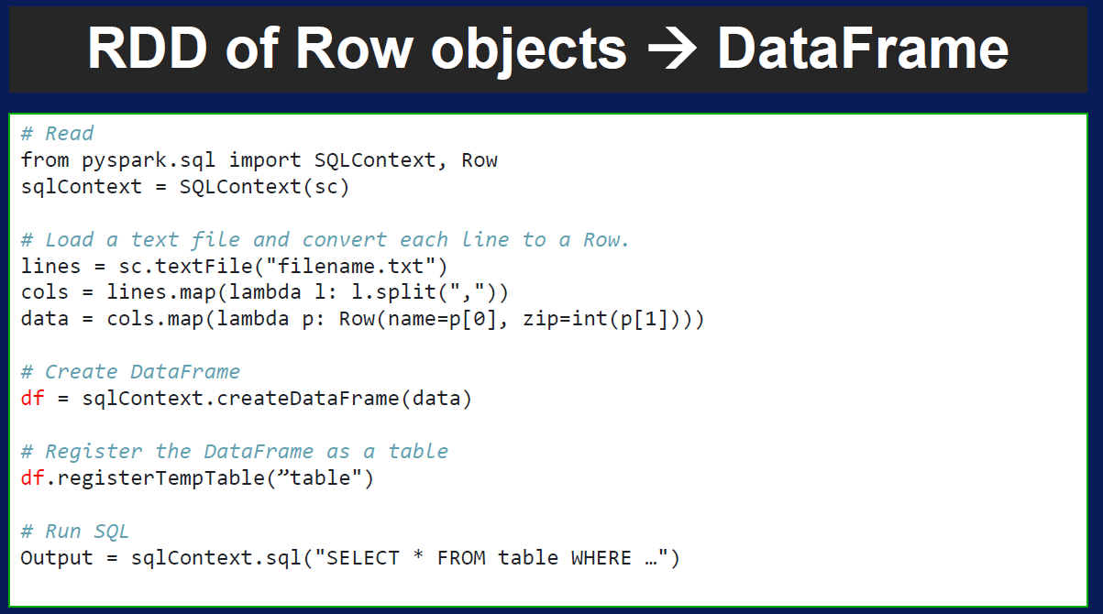
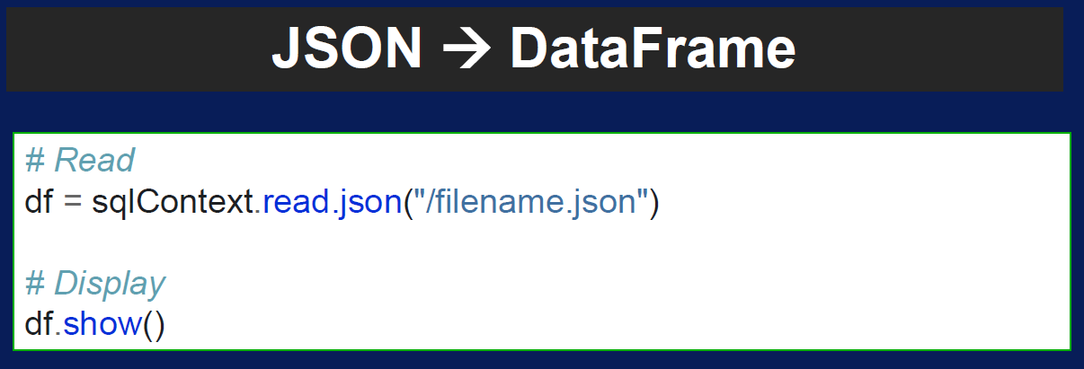
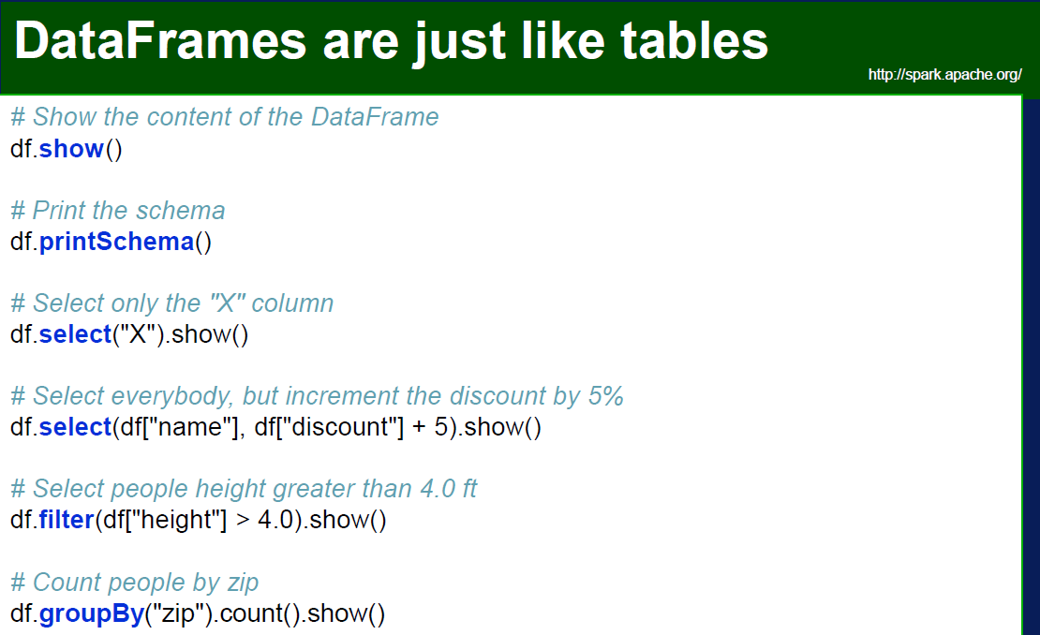
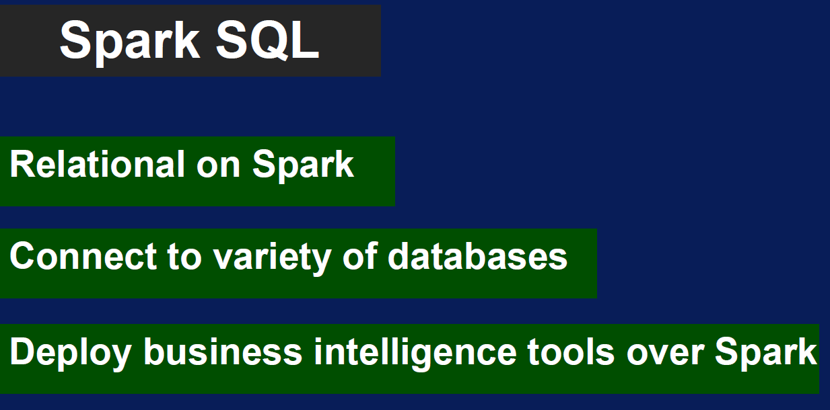
Spark SQL
Demo: Using Spark SQL DataFrames

Slide 26
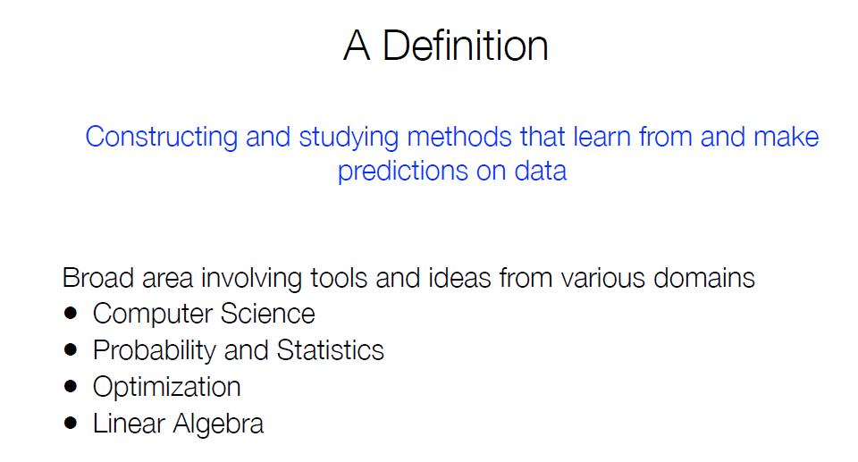
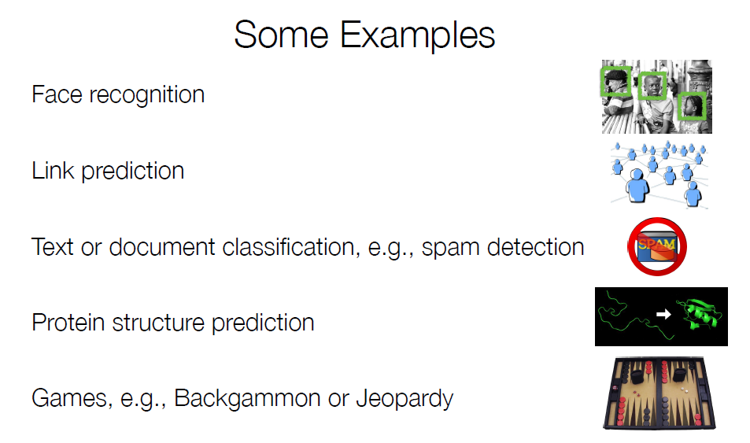
What is Machine Learning?

Slide 27
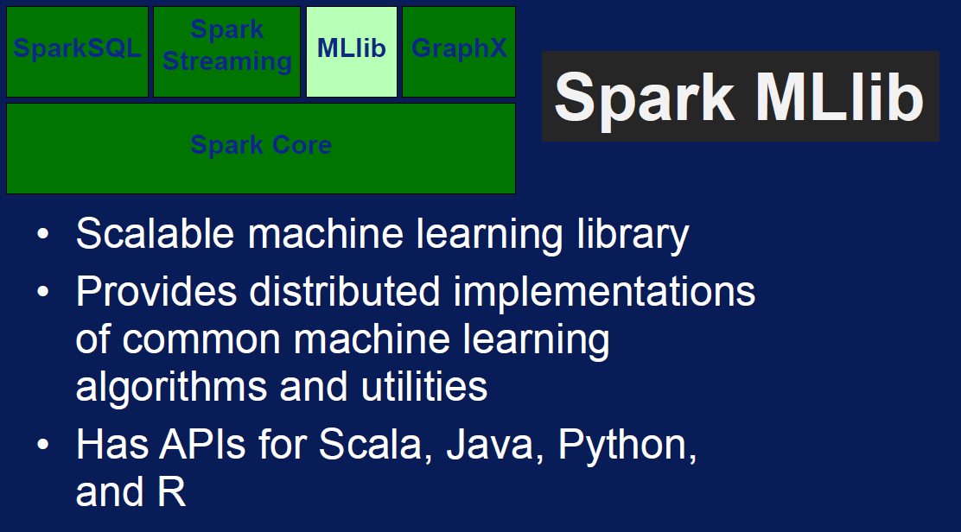

What is MLlib?

Slide 28


How does Machine Learning work?

Slide 29

How to.. Machine Learning in Apache Spark?

Slide 30


MLlib Examples

Slide 31


MLlib Examples

Slide 32


MLlib Terminology

Slide 33


MLlib Terminology
Demo: MLlib applications

Slide 34
Now what?

